Slide 1

TEAM MATRIX
Dev Agarwal (Tech Lead @ gooey.ai) Rohit Anand (MLE@Glance)

Slide 2
What is MATRIX
Introducing: Your AI-Powered Personal Voice Agent
Instant Search: It finds anything you need
Effortless Scheduling: It manages your calendar, creating and deleting events
Seamless Communication: It sends emails at your command
Your Language, Your Way: All interactions happen in your preferred language

Slide 3

Why MATRIX...
Smartphone Accessibility:
Over 2 billion people worldwide lack access to smartphones
Internet Connectivity:
Approximately 3 billion people worldwide are without Internet access.
Email Availability:
Nearly 3 billion people worldwide do not possess email addresses
Language Diversity:
English is unfamiliar to 85% of the global population

Slide 4
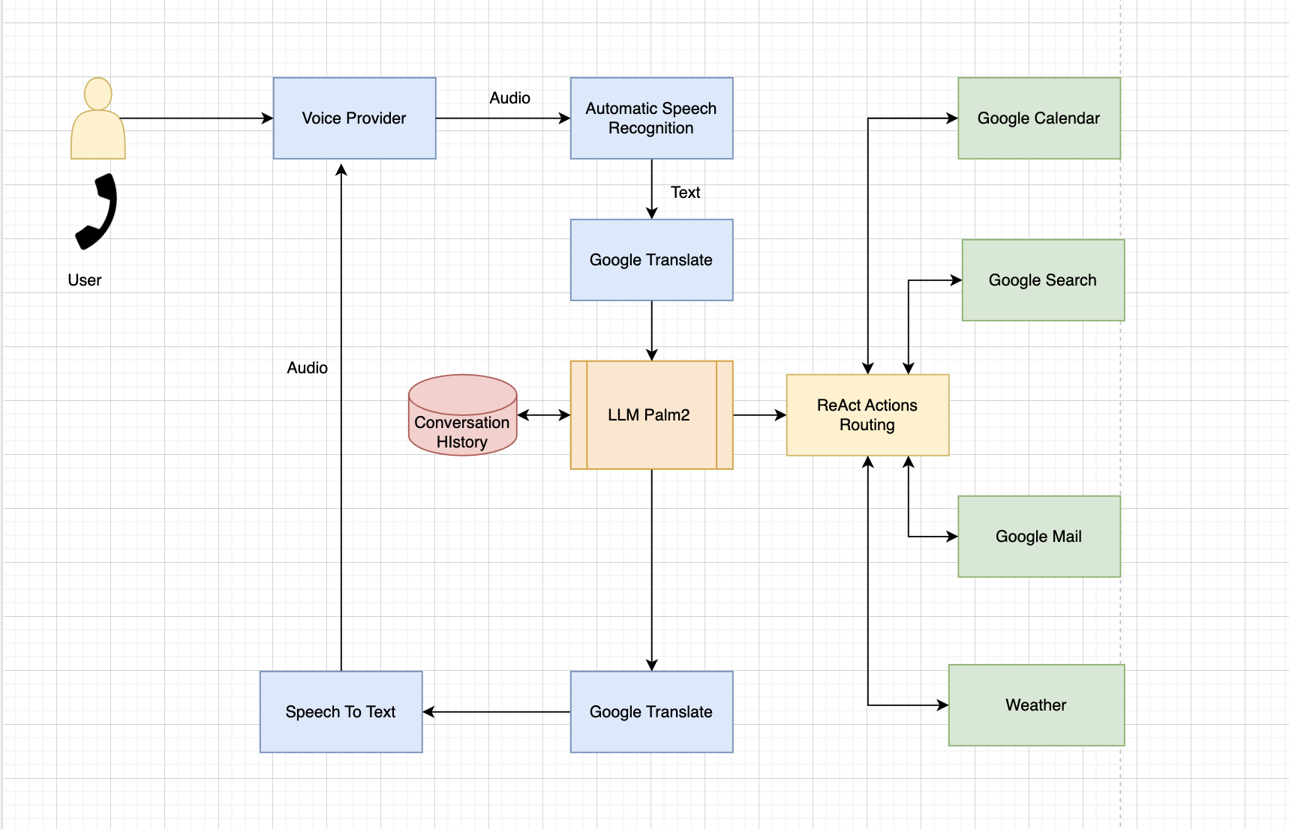
Solution Architecture

Slide 5

Demo

Slide 6
Prompt...
VOICE PROMPT COMMAND

Slide 7
Use cases and Impact
High Availability and Penetration:
No Internet Required: Reaching billions in disconnected areas
Seamless Access: Providing continuous service availability
Versatile Integration:
Pluggable Powerhouse: Fits into a wide range of applications
Universal Telephonic Frontend: Enabling diverse Gen AI solutions
Transforming Customer Success:
Unprecedented Impact: Reshaping the call centre industry
Efficiency and Accessibility: Elevating customer experience

Slide 8

Thank You

